Slide 1




TYPES OF TESTING
By Supraja C
Emp id:6142

Slide 2
WHAT IS SOFTWARE TESTING?
It is the process of evaluating & verifying that a software product or application does what it is supposed to do.
It prevents bugs, reduces development cost & improves performance

Slide 3
TYPES OF SOFTWARE TESTING
Unit testing
Integration testing
Regression testing
Smoke testing
Alpha testing
Beta testing
System testing
Stress testing
Performance testing
Object Oriented testing

Slide 4

Unit testing
It is a type of software testing where individual units or components of a software are tested.
The purpose is to validate that each unit of the software code performs as expected.
Unit Testing is done during the development (coding phase) of an application by the developers.

Slide 5

Integration testing
It is also abbreviated as I&T.
It is the phase in software testing in which individual software modules are combined and tested as a group.
Integration testing is conducted to evaluate the compliance of a system or component with specified functional requirements.

Slide 6
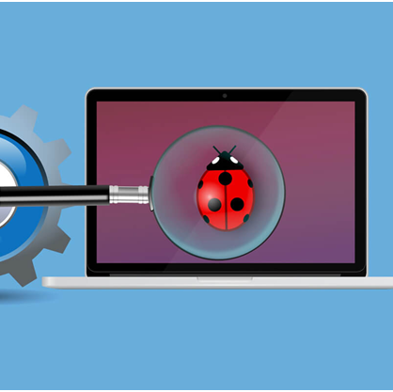
Regression testing
Testing existing to the software applications to make sure that a change or addition hasn't broken any existing functionality

Slide 7
SMOKE TESTING
Smoke Testing is a software testing process that determines whether the deployed software build is stable or not. ... It consists of a minimal set of tests run on each build to test software functionalities. Smoke testing is also known as “Build Verification Testing” or “Confidence Testing.

Slide 8
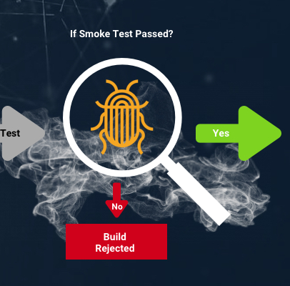
SMOKE TESTING​
It is a software testing process that determines whether the deployed software build is stable or not.
It consists of a minimal set of tests run on each build to test software functionalities
It is also known as “Build Verification Testing” or “Confidence Testing.​

Slide 9
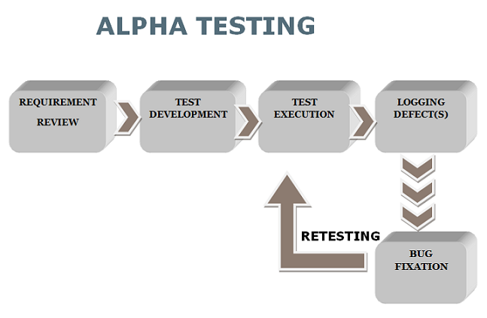
ALPHA TESTING
Alpha testing is the first end-to-end testing of a product to ensure it meets the business requirements and functions correctly.
It is typically performed by internal employees and conducted in a lab/stage environment.
An alpha test ensures the product really works and does everything it's supposed to do.

Slide 10
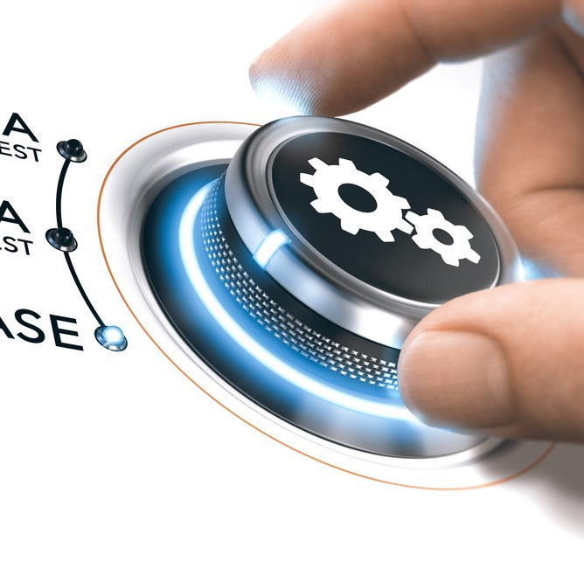
BETA TESTING
Beta testing is an opportunity for real users to use a product in a production environment to uncover any bugs or issues before a general release.
Beta testing is the final round of testing before releasing a product to a wide audience.

Slide 11
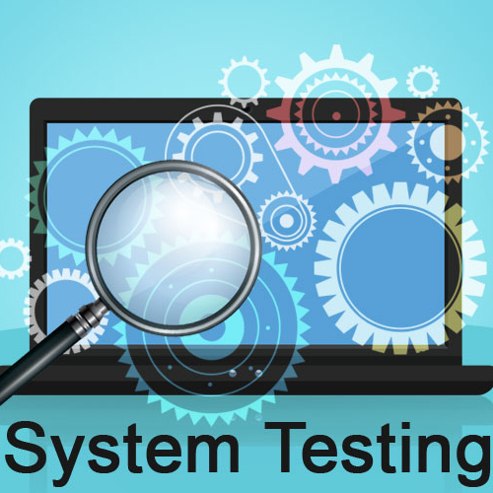
SYSTEM TESTING
System testing is defined as testing of a complete and fully integrated software product.
This testing falls in black-box testing wherein knowledge of the inner design of the code is not a pre-requisite and is done by the testing team.

Slide 12
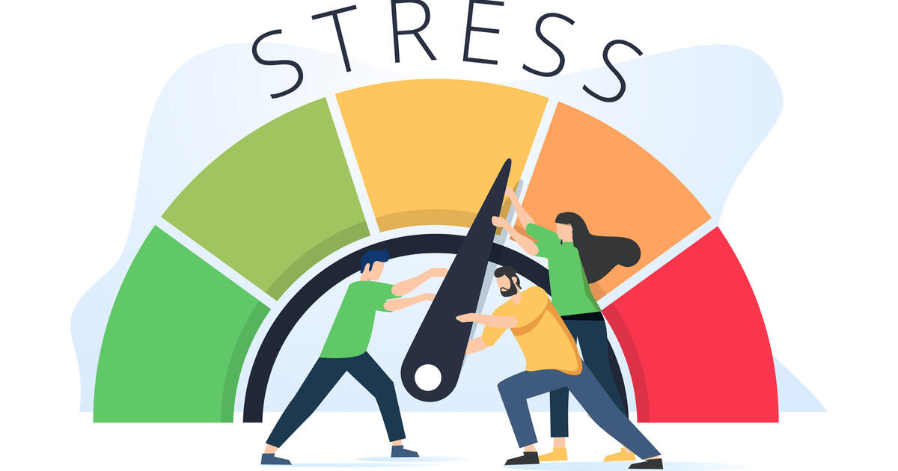
STRESS TESTING
It is a form of deliberately intense or thorough testing used to determine the stability of a given system, critical infrastructure or entity.
It involves testing beyond normal operational capacity, often to a breaking point, in order to observe the results.

Slide 13
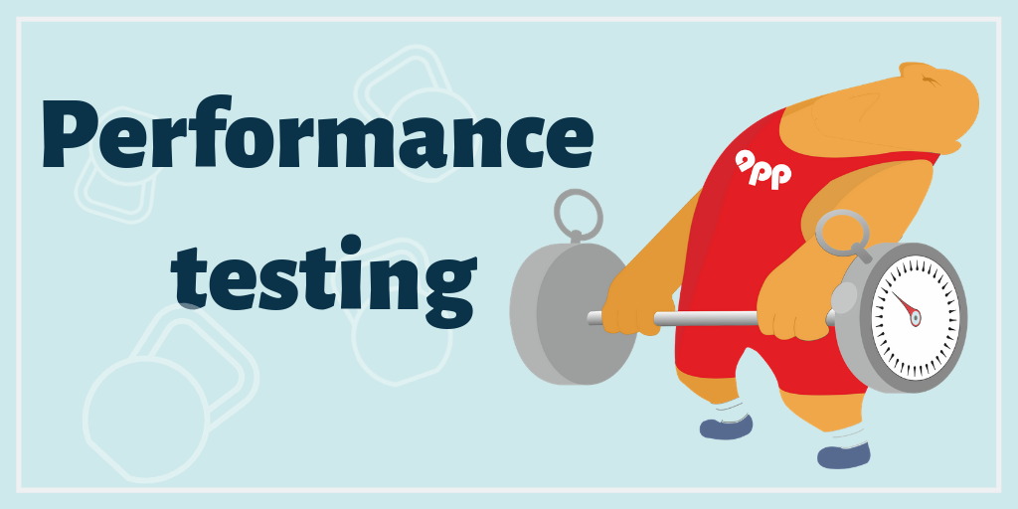
PERFORMANCE TESTING
Performance testing is a non-functional software testing technique that determines how the stability, speed, scalability, and responsiveness of an application holds up under a given workload.

Slide 14

OBJECT ORIENTED TESTING
In the object-oriented model, interaction errors can be uncovered by scenario-based testing.
This form of Object oriented-testing can only test against the client's specifications, so interface errors are still missed.

Slide 15

THANK YOU!

